Slide 1
Take Home Test 2
Team B
Tyler, Jaimee, Brad, Max, Shaquille, Brent, Dan, Nick, and Matt

Slide 2
History
JavaScript was created in 1995 by Brendan Eich while working for Netscape
It was originally conceived to be an“object-based scripting language”

Slide 3
History
Before JavaScript, web browsers were very basic pieces of software capable of displaying hypertext documents.
JavaScript was created in order to add more “spice” and interactivity to web pages.

Slide 4
History
At the time of JavaScripts release, Netscape dominated the browser market.
Microsoft set out to create its own version of JavaScript eventually called Jscript.

Slide 5
History
In response to this, Netscape, and Microsoft, with help from the European Computer Manufacturers Association (EMCA), set out to standardize the language.

Slide 6
History
While JavaScript is not truly a functional language, it does support some constructs typical of a functional language.
By using existing constructs, JavaScript is capable of functional programming.

Slide 7
History
Anonymous functions are the building blocks of functional programming in JavaScript. They are used when you want to pass functions are parameters.
Anonymous functions are direct offshoots from lambda calculus.

Slide 8
History
Another concept from functional programming in JavaScript, closure, was added in version 1.8

Slide 9
Lazy Evaluation: The Idea
Lazy evaluation: waiting until the last possible moment to evaluate an expression, often for the purpose of optimizing an algorithm
At the time of evaluation, the data used in a calculation must be available and meaningful
Pros:
performance increase (avoids unnecessary calculations)
beneficial for recursion
reduction in memory footprint
Cons:
timing must fall in “window of opportunity” if language supports state change
may be counter-intuitive and difficult to implement, particularly with:
exception handling
input/output

Slide 10
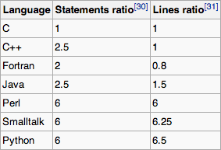
Expressiveness
Expressiveness of a language is the ability for programmers to say what they want done, rather than how they want it done. Expressive languages allow simple statements to do complex operations.
Lazy Evaluation boost expressiveness by allowing things like infinite list comprehension, etc.
expressiveness of many common languages

Slide 11
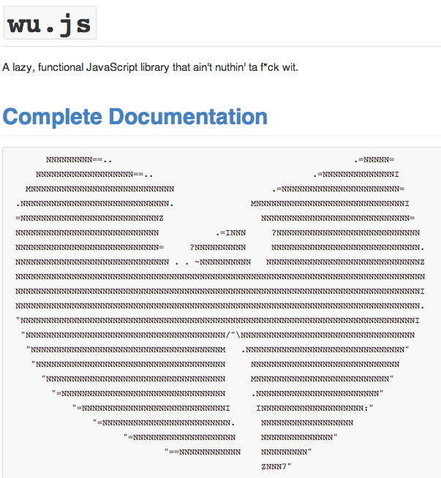
Lazy Evaluation in JavaScript
Lazy.js Javascript library
Allows functions to be ‘chained’ together without evaluation until the final step
Methods aren’t evaluated until the ‘each’ method is called
wu.js
inspired by Haskell
includes many higher order functions

Slide 12
Javascript: Array comprehension
Array comprehensions were introduced in JavaScript 1.7. Comprehensions are a well-understood and popular language feature of list comprehensions, found in languages such as Python and Haskell, inspired by the mathematical notation of set comprehensions.
Array comprehensions are a convenient, declarative form for creating computed arrays with a literal syntax that reads natural
ex 1 : var numbers = [1, 2, 3, 21, 22, 30]; var events = [i for (i of numbers) if (i % 2 === 0)];
returns an array that contains all the even numbers from numbers, [2,22,30].
ex 2 : var numbers =[1, 2, 3, 21, 22, 30]; var doubledEvens = [i * 2 for (i of numbers) if (i % 2 === 0)];
returns an array that contains the double of the even numbers from numbers, [4,44,60].
combines the map() and filter() type comprehensions.

Slide 13
Haskell: List comprehension
One may have multiple generators, separated by commas.
[(i,j) | i <- [1,2], j <- [1..4]]
yields the result [(1,1),(1,2),(1,3),(1,4),(2,1),(2,2),(2,3),(2,4)].
One can also provide boolean guards(predicates).
take 10 [ (i,j) | i <- [1..], j <- [1..i-1], gcd i j == 1 ]
yields [(2,1),(3,1),(3,2),(4,1),(4,3),(5,1),(5,2),(),(5,4),(6,1)]5,3
One can also make local let declarations.
take 10 [ (i,j) | i <- [1..], let k = i*i, j <- [1..k]]
yields [(1,1),(2,1),(2,2),(2,3),(2,4),(3,1),(3,2),(3,3),(3,4),(3,5)].
These generators and predicates are read left to right, allowing for customisation of comprehensions
Notes:
One must be careful of the left-to-right as well, as switching the order of predicates may change your comprehension to one you did not intend

Slide 14
JS:Array comprehension VS Haskell: List comprehension
Both Haskell and Javascript use predicates to filter() their lists/arrays
Haskell has the benefit of being able to use multiple predicates to further filter the elements in a list
Haskell is also unique in the way that it reads its generators and predicates from left to right.
In Javascript, one would have to write a new comprehension to do so
Both Haskell and Javascript allow you to apply functions to each element of a list/array and then return the result in the return array
easy ways to implement the map() function in one line

Slide 15
JS:Array comprehension VS Haskell: List comprehension
While the two languages are very similar in their use of comprehensions, it is Haskell that is more expressive. It is much easier to manipulate and filter the elements of a list in many ways all in one comprehension.

Slide 16
Higher-Order Functions And Closure
What is a higher order function?
A higher-order function does at least one of the following:
take one or more functions as parameters
returns or outputs a function

Slide 17
Higher-Order Functions And Closure
Example of a Higher-Order Function:
function lazyOperator(x,y,func) {
var result = func(x,y);
}
function add(x, y){
return x+y;
}
lazyOperator(1,2,add);
Notes:
NOTICE lazyOperator takes the function add(x, y) as a parameter!

Slide 18
Higher-Order Functions And Closure
What is a closure?
A closure is a function (or reference to a function) together with a table storing a reference to each of the free variables of that function. A closure allows a function to access those non-local(free) variables even when invoked outside its immediate lexical scope.
A closure is made when you create a nested function. This nested function can then bind the free variables of its parent function and use the values after the parent function no longer exists.

Slide 19
Higher-Order Functions And Closure
Example of Nested Functions in JavaScript
function numbers() {
var num = 1 // local variable
function incrementnum() {
num++; //now num is 2
}
function squarenum() {
num = num * num; //now num is 4
}
return num; //returns 4
}
Num is bound in a closure by the two nested functions so that when num is no longer available because numbers is gone, squarenum() and incrementnum() will still be able to manipulate the value of num that is referenced by the closure.

Slide 20
Higher-Order Functions And Closure
Example of a closure in Lambda Calculus:
λx.x y
λx. → introduces a new scope which lasts for the length of the lambda expression, and x is a local variable in that scope.
λx.x → the x defined is now bound to the local variable x in the scope.
λx.x y → y is a free variable. We can pair this open lambda term with an environment that maps variables to values
λx.x y [y = 2] is a closure because y is a free variable which is now assigned.

